Slide 1
Understanding Y haplotype evidence –
(forget what you know from autosomal)
Charles Brenner, PhD
DNA·VIEW and UC Human Rights Center
www.dna-view.com cbrenner@berkeley.edu
Brenner CH (submitted 2012) Understanding Y haplotype evidence
Brenner CH (2010) Fundamental problem of forensic mathematics – The evidential value of a rare haplotype
Forensic Sci. Int. Genet. 4 281–291

Slide 2

Context and thesis
Suppose (context): Crime scene YfilerTM Y haplotype = T.
  T unobserved (usually) in reference database.
  Want the Random match probability=
  Pr(random man=T | T seen at crime scene)
  Or maybe want Pr(randoman=S | S ⊂ T, T a mixture)
Thesis:
  We need to understand what the Y haplotype terrain looks like – data, population genetics, history ...

Slide 3
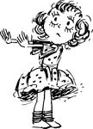
Exploring the world of Y haplotypes
Ways to explore:
  Data
  Theory
  Simulations
  Analogy with autosomal methods
Obvious to adapt autosomal methods but
bad idea for at least 8 reasons
Y haplotype terrain NOT like autosomal !
Start from scratch.

Slide 4
Initial reason autosomal way wrong for Y
Obviously product rule is out for Y haplotypes –
nothing new, everyone knew that.

Slide 5
Exploring Y data
Data: 4102 U.S. Caucasian YfilerTM haplotypes (from ABI)
  Empirical RMP (i.e. pairwise match rate) = 1/8800.
  κ = 84% (3439 men) are “singletons” (unique type).
Therefore it is 84% that the crime type T is a new type (Brenner 2010)
  RMP = (1-κ)/n = 1/25000 for a new type (Brenner 2010).
  Sample frequency = 0/4102 or 1/4103.
  ☞ sample frequency is not a logical or realistic estimate for RMP
  (unlike in the autosomal situation)
1/8800
1/25000
Notes:
Explain 1/25000 partly by comparison to 1/8800

Slide 6
RMP ≠ sample frequency (not even close) so …?
Sketch of answers:
  Sample database is data – Consider whole database (e.g. # of singletons), not just T.
  Model – Need population genetic theory from which we can calculate how haplotypes come and go.
Now back to the story
Notes:
When we lose our familiar crutch of sample frequency as an estimator for matching probability, what is left?

Slide 7
Evolution of the Yfiler lineages
mutation
“Adam”
Convergent mutation (rare)
…
110,001 ybp
110,000 ybp
(Same color = same Y-haplotype)

Slide 8
Exploring Y haplotype simulations
Men
with
haplotype ☞
… (1000’s more)
R
S
T
U
V

Slide 9
Exploring Y haplotype simulations
Men with haplotype
T
S
U
V
R
…
…

Slide 10
Genealogy of a haplotype T
MRCA (ca 1700)
Major IBD* group
98+% of T haplotypes related without mutation
Pr(IBD | IBS) = 97%
300 years
97%
Minor IBD groups
* IBD: Identical by descent
=related without mutation
1000 men

Slide 11
Influential difference
Autosomal STR allele A
Y haplotype T
Many IBD A families
5% of matching is IBD
Convergent mutation common
One dominant IBD T family
97% of matching is IBD
Convergent mutation insignificant
10000 years

Slide 12
Thinking about theta – θ=Pr(IBD match)
For Y, recall: 1/25000 = Pr(random match | new type T)
1/8800 = Pr(random match) = average Pr(T|T)
97% = Pr(IBD|IBS)
Therefore θ = 97% /8800 = 1/9000.
Autosomal: Pr(A|A) = Pr(non-IBD match) + Pr(IBD match)
= p_{A} (1- θ) + θ.
Y: Pr(T|T) = p_{T} (1- θ) + θ?
1/25000 = p_{T} (1- θ) + 1/9000?
Requires p_{T} < 0. Meaning? Not a probability!
5% refinement
?% refinement

Slide 13
Y haplotype considerations vs Autosomal
Topic | Y haplotype | Autosomal
Product rule | No | Yes
Sample frequency | Not close to RMP | Close enough to RMP
Reference database | Consider all types | Consider target type
Confidence intervals | Crippling mistake | Harmless error
“Unrelated man” | Misses the whole point | Ok approximation
Theta | Practically RMP | Minor refinement
Models | Essential point of view | Not so vital
Geographical clustering | Of concern | Not so much

Slide 14
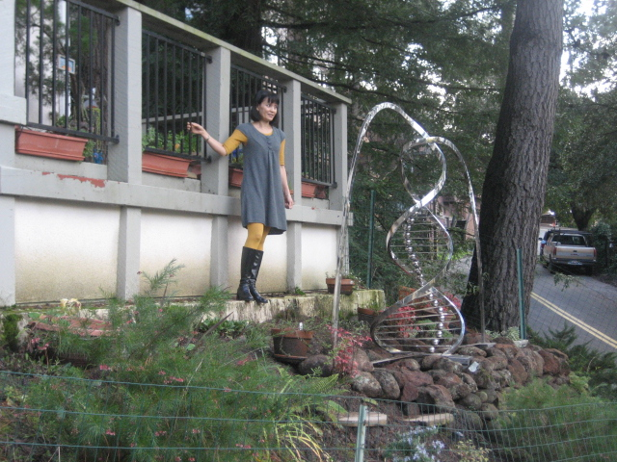
The end
The rules of genetics are simple. Their consequences are not always obvious.
This work received no support from the NIJ, IMF, World Bank, Bill and Melinda Gates, or the Ford Foundation.
Even Queen Isabella of Spain, usually a soft touch, didn’t pitch in.

Slide 15
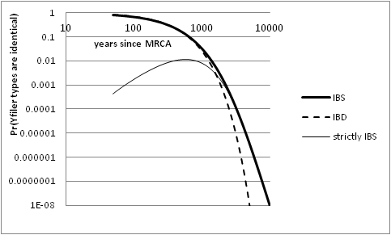

Slide 16
Understanding Y haplotypes
  Evolutionary history and population genetics
  Evidential value

Slide 17
Mathematical formulation of “Evidential value of a match”
Where do we start?
  B Weir: Likelihood Ratio
  Simplest problem first
LR= ¹/Pr(match crime scene Y haplotype S | random suspect)
Problem is then to evaluate the denominator probability
  Think prospectively: Given the crime scene type S, how surprised will I be if a random (i.e. innocent) man matches?

Slide 18
(forensic) mathematical exposition
Features / paradigm
Benefits
State problem
Formulate it mathematically
State premises
  What is the model?
Justify the premises
  Validate the model.
    Test=innocent suspect
Derive the result
Communicate
Explain accurately
Logical; persuasive
  Linear deductive organization
Facilitate discussion/argument
  Where do we disagree?
    Premises? Reasoning step?
  Resolution
Notes:
The linear deductive organization justifies the claims or recommended method.

Slide 19
Rare haplotype matching probability
Features / paradigm
Brenner paper [FP]
State problem
Formulate it mathematically dummy line
State premises
  What is the model?
Justify the premises
  Validate the model.
    Test=innocent suspect
Derive the result
Evidential value of match?
Pr(innocent suspect matches | crime scene, database)
Type is (mostly) just a name
  “equal over-representation”
Validation by tediously simulating/examining suitable range of populations
LR=n/(1-κ) (for new type)
  n=reference database size+1
  κ=singleton proportion
Notes:
The linear deductive organization justifies the claims or recommended method.

Slide 20
2. Invalid counterexample
In [FP] I construct an artificial population Ω^{t} (many exactly equally rare types) where my method would not work.
  Ω^{t} :
Reason – to explain that
  κ method doesn’t claim to be a mathematical identity
  but rather depends on evolutionary mechanisms – on reality,
  hence the example motivates the need for validation.
The validation shows that the method works in reality.
[BKW] cites my example as counterexample to my method!
  Misunderstand 2 & overlooked 3.
  In particular [BKW] says the opposite of 2A.
… (t=1000 types)
☞
☞
Notes:
“my example” – and noted it as mine. Hence they write as if my paper includes it’s own disproof! Shouldn’t that thought ring an alarm, suggest re-reading more carefully?

Slide 21
All men are related
All men alive today have a common Y-chromosome ancestor
(probably 3,000 generations ago)

Slide 22
Identity by descent or by state?
Two men have the same Yfiler haplotype.
Connected to a common ancestor without mutation (IBD), or not?
(Terminology:
  IBD = Identity by descent = related with no intervening mutations
  IBS = Identity by state = same haplotype maybe coincidentally)

Slide 23

Convergent Y mutation
Y haplotype = 17 numbers = position in 17-space
Mutation is random walk in 17 dimensions
  Each step is +1 or -1 in some dimension.
  2 × 17 =34
Random walks rarely return to start.
  2 mutation separation: 1/34 chance that 2nd mutation reverses 1st one.
  Probability to converge otherwise is negligible.
Identical Y-filer haplotype => relationship to common ancestor without mutations (IBD)

Slide 24
Convergence experiment
Simulated Y-filer population (N=90000)
Small proportion of pair-wise matches
  Pr(match)= 1/9000
Given match (IBS), are all IBD?
  Pr(IBD | IBS) = 33/34 (experimental, from simulation)
  Close to computed estimate of non-convergence (previous slide).
    (Why? They are not the same experiment.)

Slide 25
Time to diverge
μ ≈ 1/350 per locus per generation (1/150-1/3000)
μ ≈ 5% per generation (17 loci)
Suppose 4 generations / century
  Common ancestor century ago = 3rd cousins
  8 meioses per century of separation between two contemporary men
Pr( Y’s equal after 1 century) = 70%
Expected # differences = 4/millenium.

Slide 26
Y-haplotype divergence
32
16
8
Expected # differences
4
2
1
virtual non overlap of races

Slide 27
Comments on crime-suspect match
If suspect not donor, then
    97% that suspect and donor are IBD
    which is very unlikely if they are separated by more than a few centuries.
A 17-locus haplotype is typically represented by a small number* of men descended without mutation from a common ancestor 300 years ago.
Probably way beyond immediate family.
* 1/10000 of the population

Slide 28
probability two random men match?
Example: 1272 Caucasian men (ABI)
  808000 pairwise comparisons (big sample!)
    90% of 1272 men are singletons (no pairwise matches)
    49 pairs of matching haplotypes (49 matches)
    5 triples (5×3=15 pairwise matches)
  … in total 91 pairwise matches / 808000
  Pairwise matching rate 1/8900
Can evidential strength (new type) be less than that? (no matter what the “upper confidence” limit may be)

Slide 29
Probability of a new Y haplotype
Assume Y-filer (17 STR loci)
Probability in an actual database?
  Example: 1272 Caucasian men (ABI sample)
    90% are “singletons”
Smaller database
  If n=1, 100% singletons
Suppose we collect the entire world male population. What % of singletons?

